Slide 1

Back End Engineering-I
Project Presentation
Semester-IV(Batch-2023)
ZAIKAZONE
Supervised By : Submitted By:
Mrs. Vijaita Kashyap Hardik Goyal , 2310990680 Naman Nayak, 2310990746
Kritika Sawhney, 2310992046 Nishant Bhalla , 2310992082
Department of Computer Science and Engineering
Chitkara University Institute of Engineering & Technology,
Chitkara University, Punjab
1

Slide 2
Abstract
ZaikaZone is a comprehensive Restaurant Management System designed to streamline operations and elevate the user experience for both customers and staff. It features essential functionalities like "Contact Us," "Login," "Signup," "Book a Table," and a dynamic "Home Page," all built with cutting-edge web technologies such as HTML, CSS, JavaScript, and Node.js. The interactive frontend allows users to submit data via forms, seamlessly transmitted to the Node.js backend using the Fetch API and POST requests, with user data efficiently managed through JSON storage. ZaikaZone demonstrates expertise in web development concepts like DOM manipulation, API integration, and server-client architecture. By addressing challenges like manual reservation errors and communication gaps, it ensures smooth operations while offering a foundation for future enhancements such as real-time interactions, advanced analytics, and AI-driven customer service. ZaikaZone redefines restaurant management by bridging operational gaps and delivering exceptional efficiency and innovation.
2

Slide 3
Table of contents
1. Problem Statement
2. Objectives
3. Proposed Solution
4. Output & GitHub Project Link
5. Conclusion & Future Scope
3

Slide 4


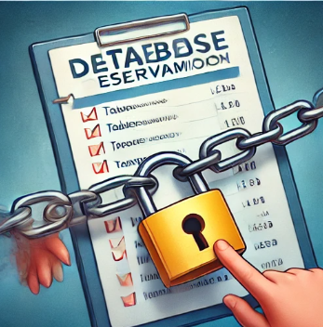
Problem Statement
Customers often book tables without their data being retained, leading to missed opportunities for personalized engagement. ZaikaZone resolves this by implementing a backend system that securely stores customer data, enabling the restaurant to identify returning customers and offer them exclusive discounts and promotions. This enhances customer loyalty while streamlining operations.
Operational Inefficiencies
Manual processes in managing
reservations and responding to
customer inquiries lead to
delays and errors.
Lack of Secure Data Management
Missed Opportunities for Customers
Customers book tables without their
data being retained, resulting in a lack
of personalized offers or loyalty
incentives.
Restaurants struggle with securely storing customer information,
risking potential data loss
or misuse.
4

Slide 5
Objectives
Some of the Objectives are given below :
1
Efficient Data Storage and Retrieval
Develop a Node.js backend to securely store and manage customer data in JSON format for efficient access and updates.
2
Streamline Backend Operations
Handle HTTP POST and GET requests to enable seamless communication between the frontend and backend.
3
Enhance Data Security
3
Use robust backend systems to protect sensitive customer information, ensuring compliance with data security standards.
4
Support Personalized Engagement
Utilize stored data to identify returning customers and generate customized offers, improving customer retention and loyalty.
5
5

Slide 6
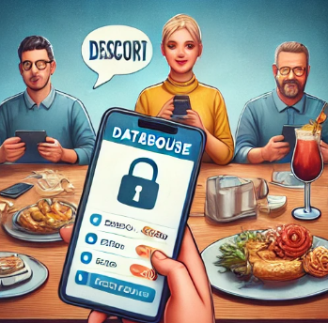
Proposed Solution
1. Implementation of a Secure Backend System
Develop a Node.js server to handle customer data storage and management using JSON files, ensuring secure and efficient data retrieval for both reservations and user authentication.
2. Automation of Operational Processes
Automate table reservations, customer inquiries, and data management through seamless server-client communication using HTTP GET and POST requests, reducing manual effort and errors.
3. Personalized Customer Engagement
4. Efficient Data Handling and Integrity
Leverage stored customer data to identify returning users and offer personalized discounts and promotions, enhancing customer satisfaction and loyalty.
Ensure reliable data handling with JSON methods for parsing and stringifying, maintaining data consistency and integrity during all backend operations.
6

Slide 7
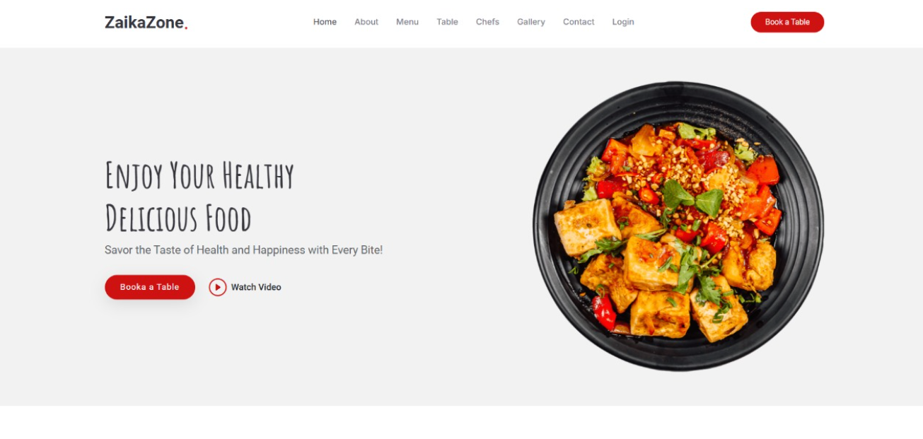
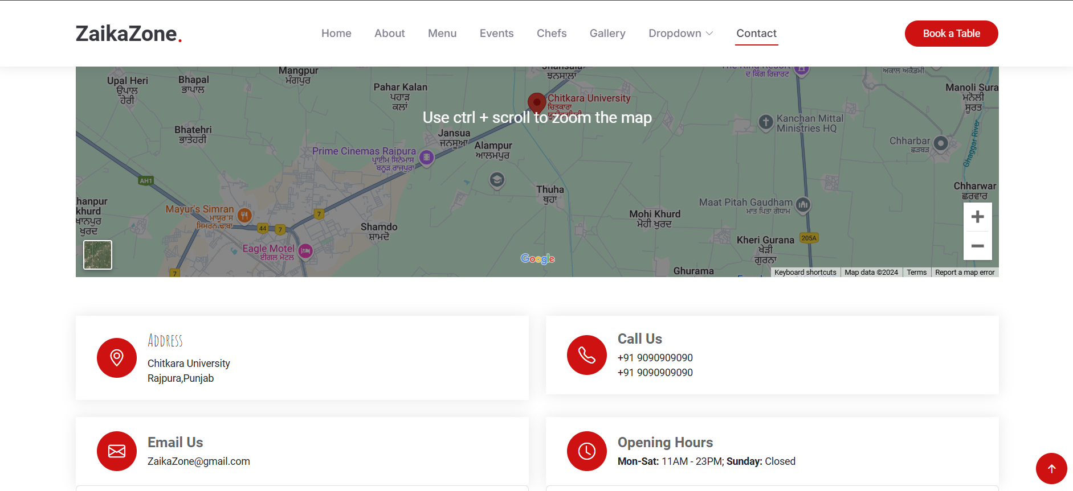
Output & GitHub Project Link
GitHub Project Link: https://github.com/Nishant-0203/BEE-1.git
1
2
7

Slide 8
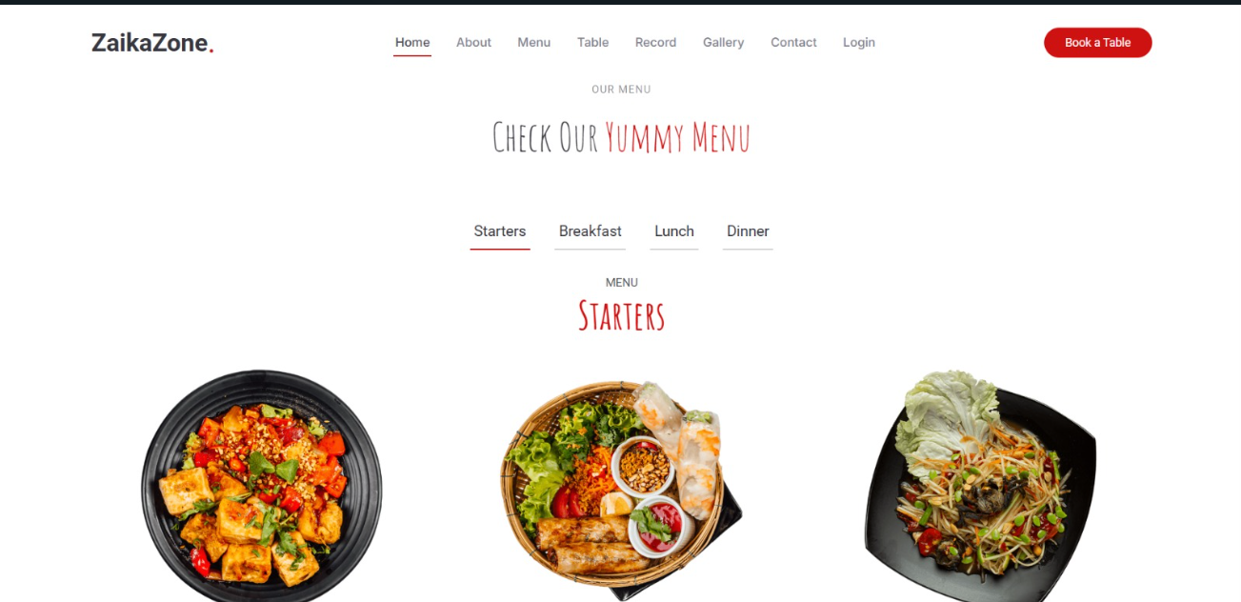
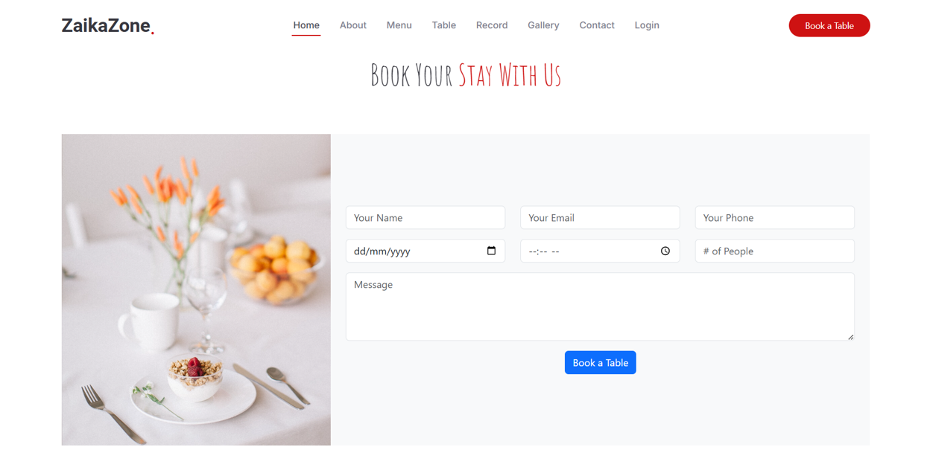
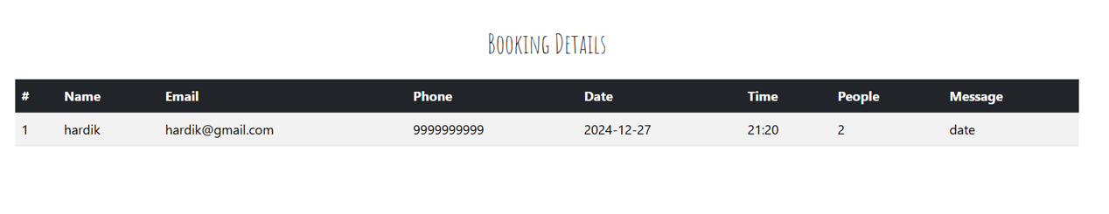
Output & GitHub Project Link
GitHub Project Link: https://github.com/Nishant-0203/BEE-1.git
3
4

Slide 9
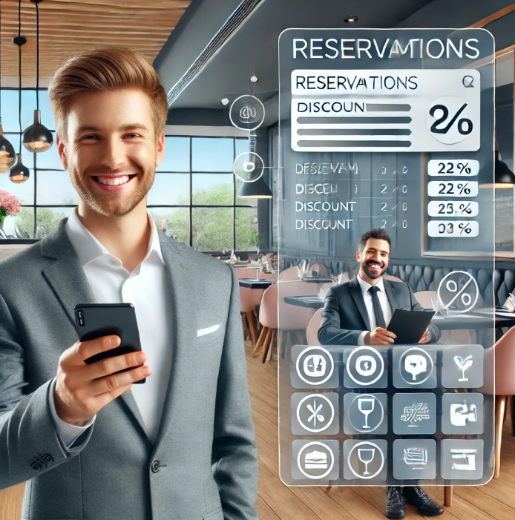
Conclusion & Future Scope
ZaikaZone successfully addresses the inefficiencies of manual restaurant operations by implementing a robust Node.js backend for secure data management and automated processes. The system not only streamlines table reservations and customer interactions but also enables personalized engagement through stored customer data, fostering loyalty and satisfaction. With its scalable architecture and seamless server-client communication, ZaikaZone is well-positioned to adapt to future enhancements and become a comprehensive solution for modern restaurant management.
FUTURE SCOPE :
ZaikaZone aims to evolve into a comprehensive platform by expanding its features to include
advanced analytics, real-time notifications, and
menu management. Additionally, the website will
be scaled to accommodate larger restaurant
chains, enhancing its reach and functionality.
9

Slide 10
Thank You
10

